Slide 1


Sports & Entertainment Marketing
Management
Minot High School

Slide 2
Section 1
Marketing Basics

Slide 3

Objectives
What is Sports Marketing
Marketing Mix
What is a Sponsorship and Endorsement and how are they different

Slide 4
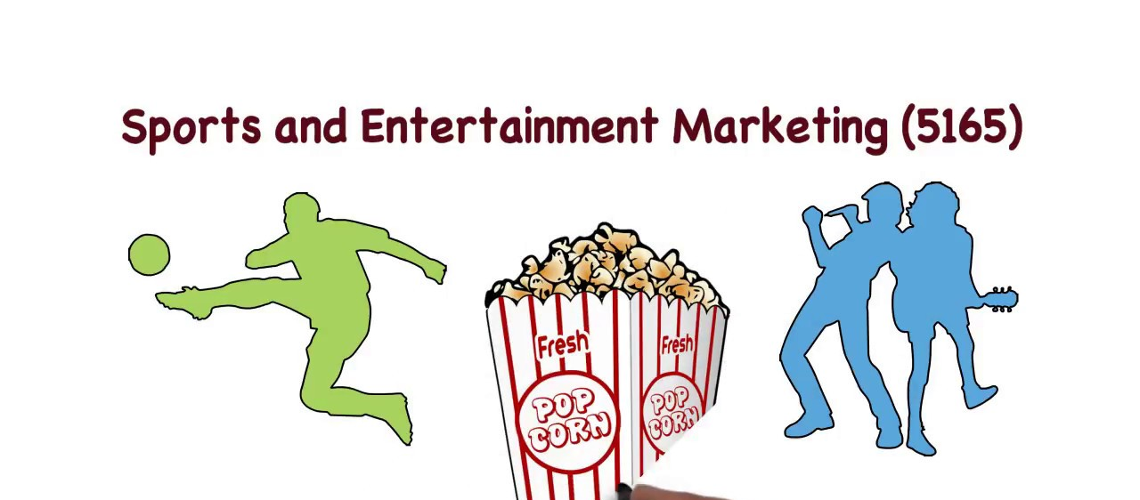
Complete the Web Activity
Page 1 - 3 of your Activity Packet

Slide 5
Discussion from Assignment
What type of jobs are available in Sports & Entertainment Marketing
Sports Agents - find players, Negotiate salaries, and form relationships among other things
Find players in all types of sports, including ice skating, basketball, hockey, football and other sports.
  Amateur players cannot sign endorsement deals
  Olympic athletes cannot accept money for playing
  but those playing at the professional level need an agent capable of getting them the best deals and helping them get exactly what they need. Negotiate salaries, form relationships

Slide 6
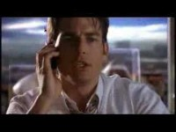
Sports Agent – Jerry Maquire

Slide 7

What is Sports Marketing
  Definition: a means of using marketing processes to sell products and services either related or unrelated to sports using sporting events
  a subdivision of marketing which focuses on the promotion of sports events, teams, or entertainment
  promotion of other products and services through these events often arise:
      apparel, toys, promotional items, parking, concessions etc.

Slide 8

Primary Focus
Selling the maximum number of tickets and other related items = make a profit
Identify events that customers want
  fans identify with their teams and build passion for them
Develop “live” entertainment products that customers consider better than other choices

Slide 9
Value of Sports Marketing
  488 BILLION dollar global industry – 623 billion by 2027
  Why is Sports Marketing Valuable (important)
    Large $$$ spent on events and related products
    Jobs created: From marketing managers to parking attendants, trainers, concessions workers, janitors, security and personal attendants etc.
    Local Businesses of Host Cities make millions
      Ex: Automobile industry – transport to/from national events and personal kids sporting events
      Ex: Restaurants, hotels, service stations

Slide 10
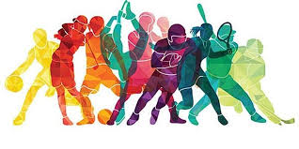
Fun Facts
  Generates an average of $488 billion in annual revenue.
  64% of Americans watch NFL football
  The NFL has $20.4 billion in television deals with CBS, FOX, ABC, and ESPN
  18,000 average NBA attendance game
  Over 73 million people attended MLB games

Slide 11

Entertainment Marketing
Entertainment = whatever people are willing to spend their money and spare time viewing rather than participating in
Entertainment is viewed in person, in broadcast or recorded form
  Movies, theater, music concerts, amusement parks, circus and so forth
Estimated 31.23bn in 2022.of US$53.13bn by 2027.

Slide 12
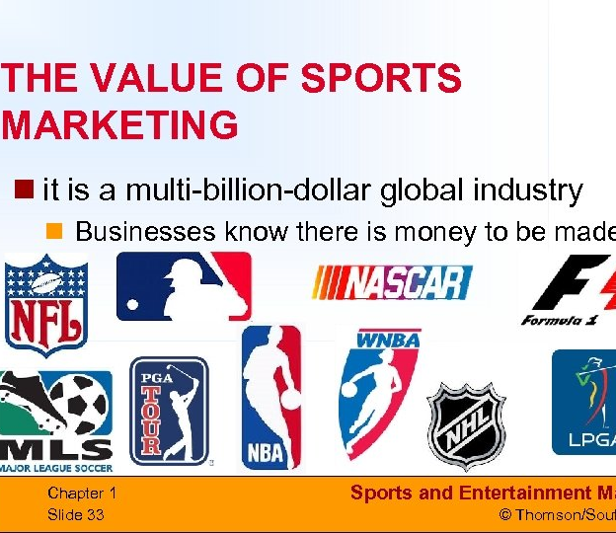
Sport Marketing Industry Value
The sporting market has a sales value of approximately $488 billion
  This amount is growing annually by 20%
Entertainment:
Estimated 678 billion U.S. dollars in 2018
  Annual growth continues

Slide 13

Assignment
In groups of 2, complete Marketing Mix in Sports and Entertainment Part A
This Photo by Unknown Author is licensed under CC BY-SA

Slide 14

When marketing Sports & Entertainment products, businesses need to create a successful mix of:
  The right PRODUCT
  Sold at the right PRICE
  In the right PLACE
  Using the most suitable PROMOTION

Slide 15
Marketing Mix
When developing plans for sports and entertainment, marketers must consider the marketing mix!

Slide 16
Product
  Definition: What you are selling
  Key components: The brand name, the various products offered under the brand, packaging and any enhancements
  Core product: main product
    What is the main product in Sports & Entertainment?
      The Event and the ticket for admission to get in
    Enhancements: features added to the basic product to satisfy additional needs. ie special seating areas, VIP packages, tiered pricing etc.
  Ancillary product: product related to or created from the core product

Slide 17
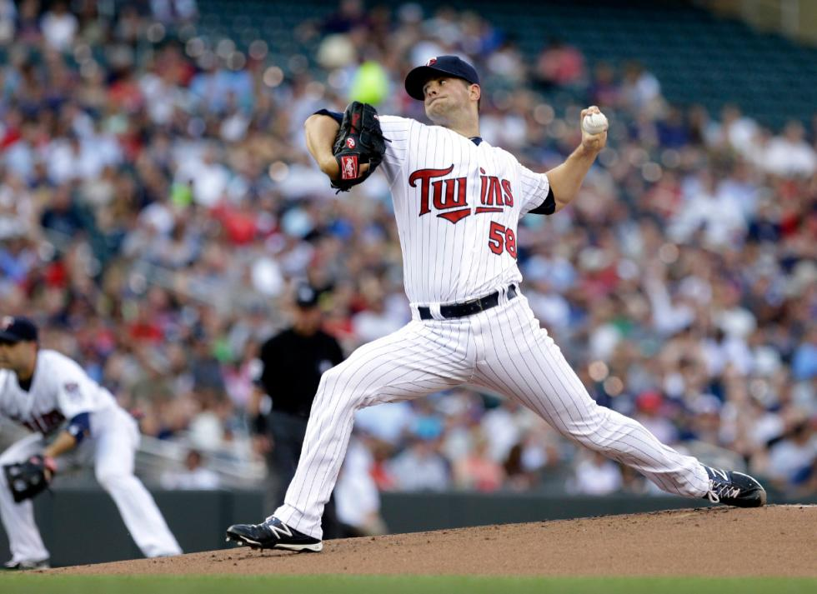
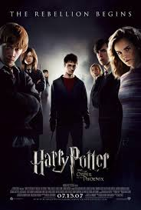
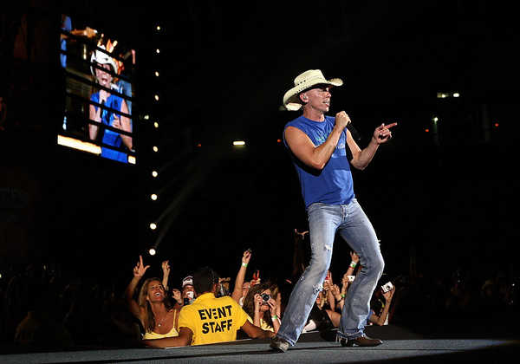
Core product

Slide 18
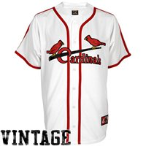
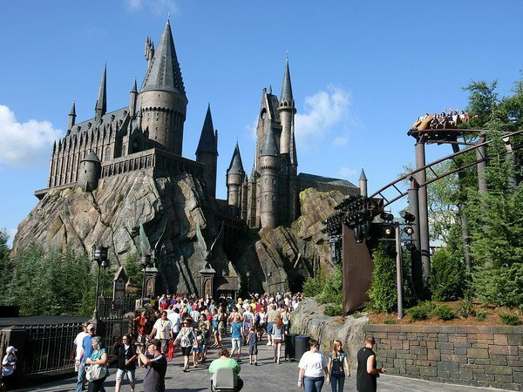
Ancillary product

Slide 19

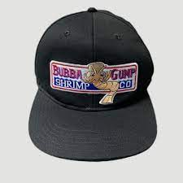
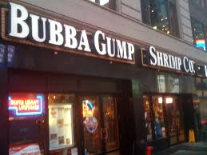
From Forest Gump Movie
What was the core product?
What is the Ancillary Products?

Slide 20
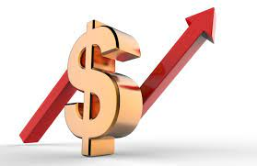
Price
Definition: What sports/entertainment venues charge for products
  What people will pay is based on:
    National importance of event
      Superbowl or Vikings Game?
    Popularity of actors/athletes?
      Who would you pay top dollar to see?
    Rivalry of the contest – Which games for Vikings are more expensive?
    How successful is the team
    Bundling of products
    Where seats are located

Slide 21
Revenue Pricing
Tickets
Parking
Concessions
Selling advertising and sponsorship space
Clothing

Slide 22
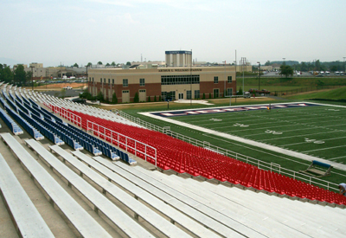
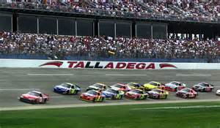
At an NFL football game, which tickets are more expensive?
  Up close to the field, or up high
  At a concert?
  What about at a race
  track?

Slide 23
Complete Group Assignment Part A

Slide 24
Check it Out
Who is the primary competitor of the Cardinals?
  Cubs
Lets Compare pricing for the Reds and the Cubs
  https://www.mlb.com/cardinals

Slide 25
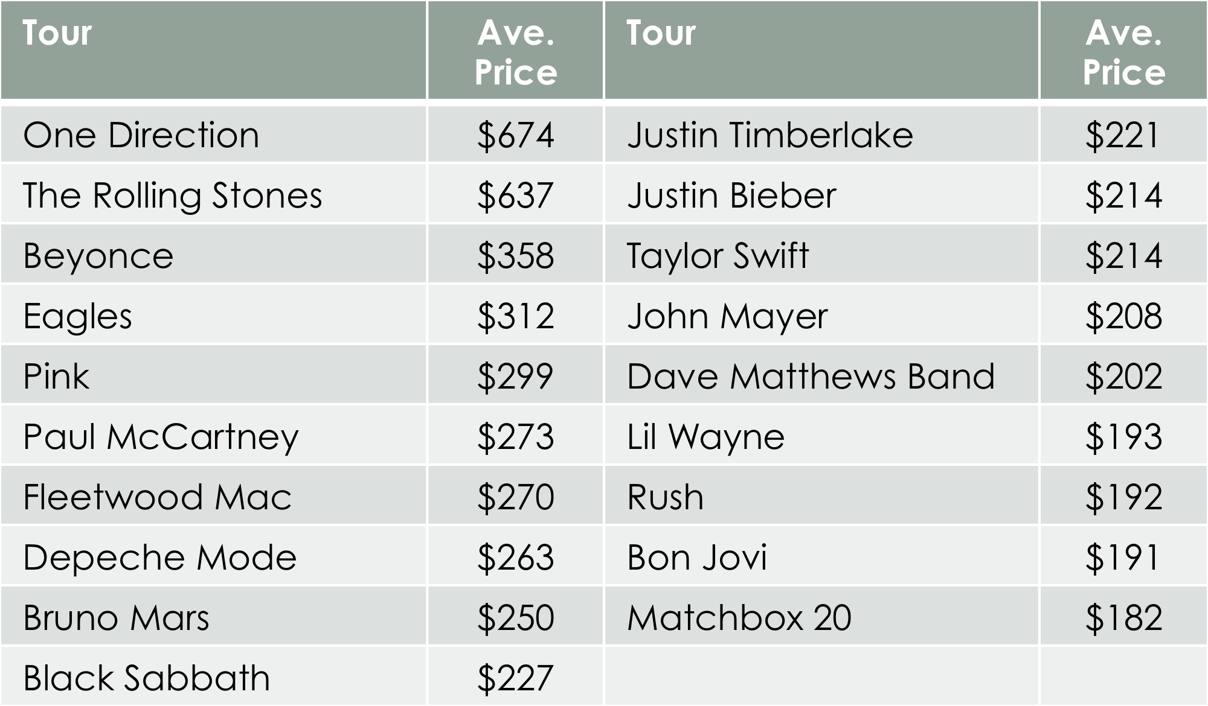

Slide 26
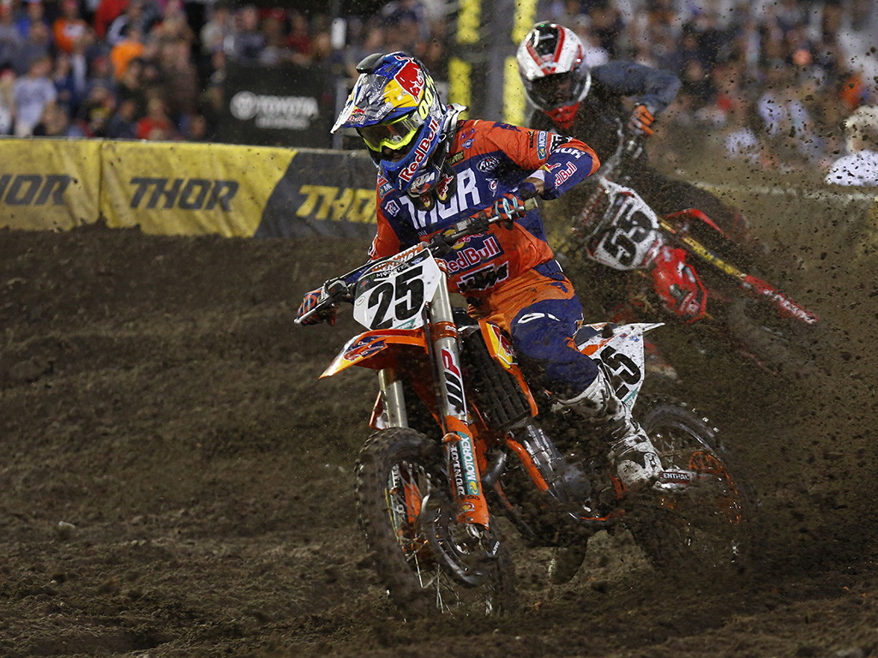
Marketing Mix Place
Place - Event location and distribution of products
  Where Ticket sales occur- direct on site, their website, online at vendors (Ticketmaster etc.) included in hotel packages
  Distribution: download, physical ticket
  Auxiliary products: people go online
  after an event to purchase related
  products, booth at events
  Bringing in props, stages etc. to make
  the place the image of the event
  ex: dirt at Daytona

Slide 27
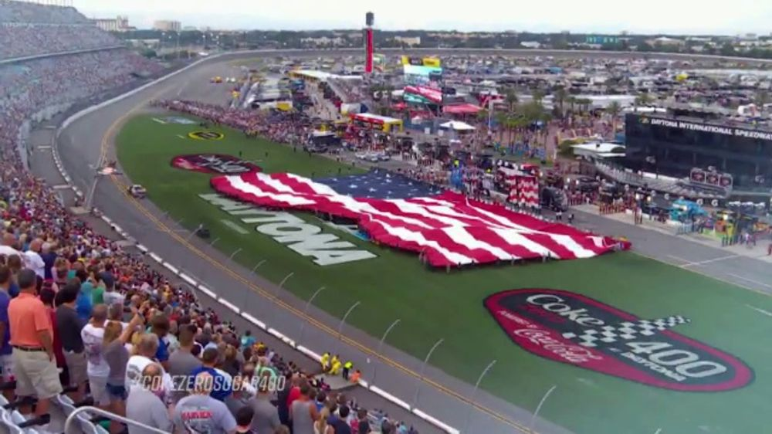
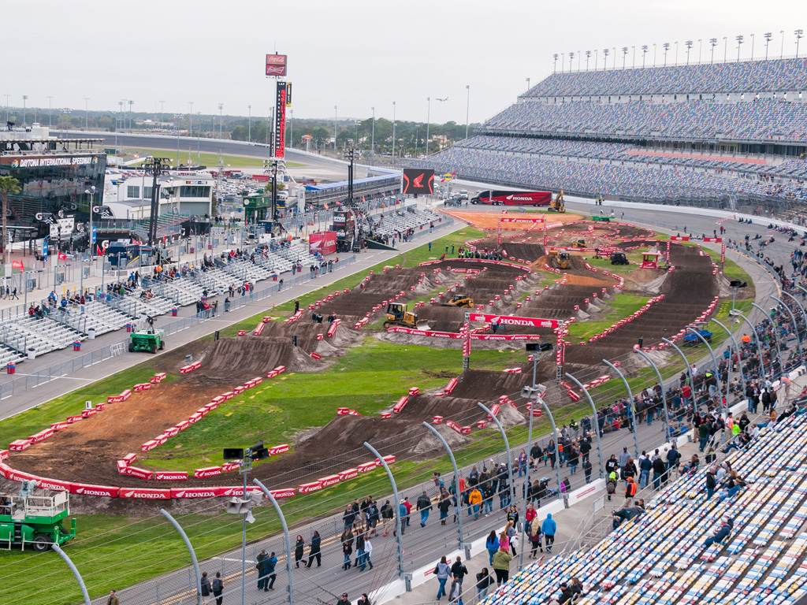
Marketing Mix Place

Slide 28
Marketing Mix Promotion
  Promotion: How you communicate your product to your customers
  Use a Promotional mix: Television, newspaper, web, and radio ads
  Digital Billboards
  Emails
  Social Media – Yours, community forums, and others
  Websites: Yours, your sponsors, and community forums
  Endorsements and or Sponsorships
  In stadium ads (coupons on back of tickets)

Slide 29
Complete Group Assignment Part B

Slide 30
Endorsement Assignment

Slide 31
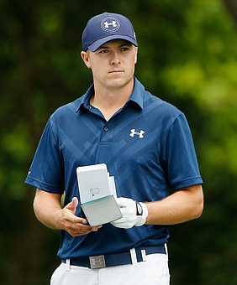
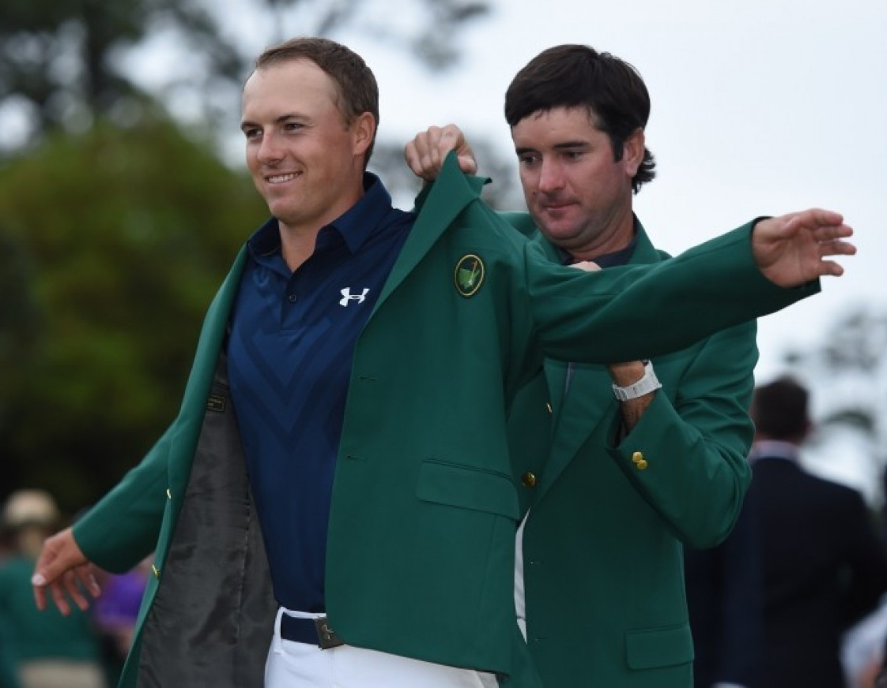
Marketing Mix Promotion
  Endorsements: a person’s public expression of approval or support for a product (goods, service, or idea).
    usually by a celebrity lending his/her image/name to a product
    Paid more in sponsorships than in
    pay checks
    Ex: Jordan Spieth
      What product does Spieth Endorse?
      How many logos was he wearing
      during the masters?
      Has a contract until 2025

Slide 32
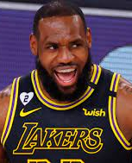
Top Deals in Endorsements
Athlete: Lebron James,
Sport: basketball (NBA – Los Angeles Lakers)
Brand: Nike
Start of endorsement: 2003 (lifetime deal)
Commonly considered one of the greatest athletes to ever grace the NBA and professional sport with his presence. A No. 1 overall draft pick straight out of high school cemented Lebron as the biggest endorsement opportunity since Tiger Woods. Before Lebron even stepped on an NBA court, he had become a millionaire through endorsement offers. At the age of 18, Lebron turned down a $10 million check from Reebok to not meet with Nike and Adidas. The footwear behemoth, Nike soon swooped in on Lebron and in 2015 he resigned for an unheard of
  $1 Billion (minimum) lifetime deal
  one of the largest (if not the largest) Nike endorsement deals in history. Is there any better contract than a Nike lifetime contract?

Slide 33
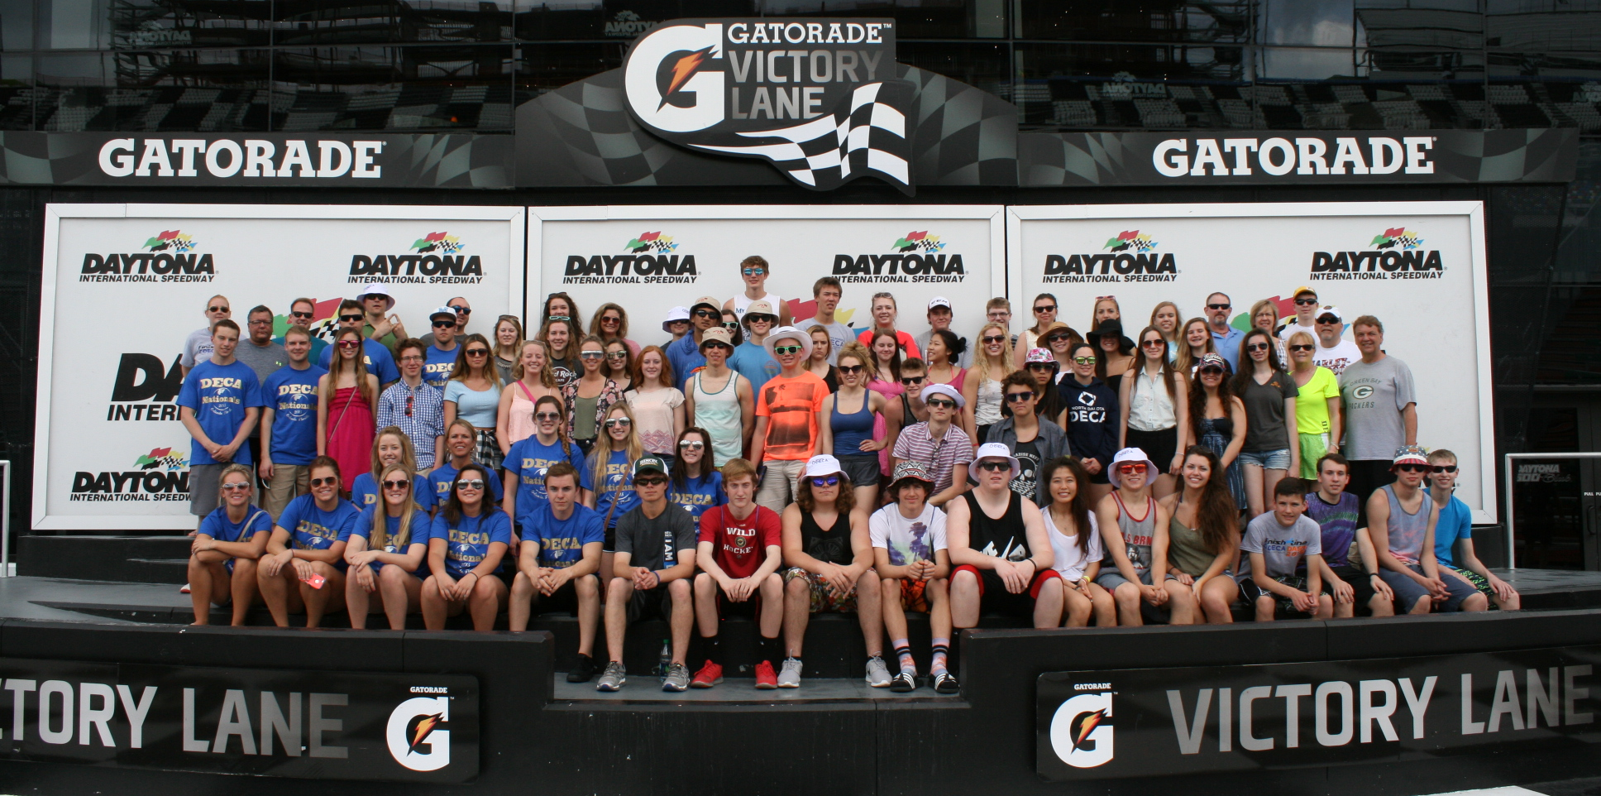
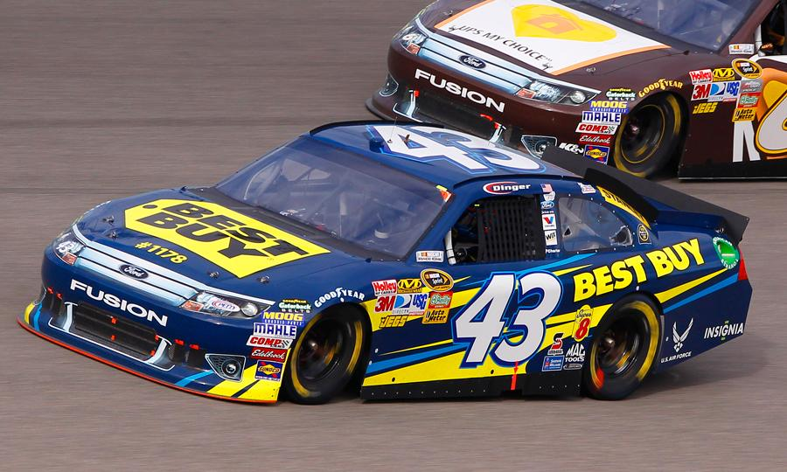
Marketing Mix Promotion
  Sponsorships – an organization, or business that gives money or donates products and/or services to another organization or event in exchange for public recognition

Slide 34
Sponsorships
Sponsorship is much more than an outfield sign at a baseball park or a logo on a racecar.
Sponsorship provides, business access, connections, hospitality, audience access, data, and helps to shape public perception
Sponsors gain brand awareness and increased brand preference
Exclusive rights to the event – competitors not allowed
Sponsors may use the images and logo of the partner and call themselves an official sponsor of the property.
Millions are spent on sponsorships

Slide 35
Google Classroom Assignment

